Slide 1
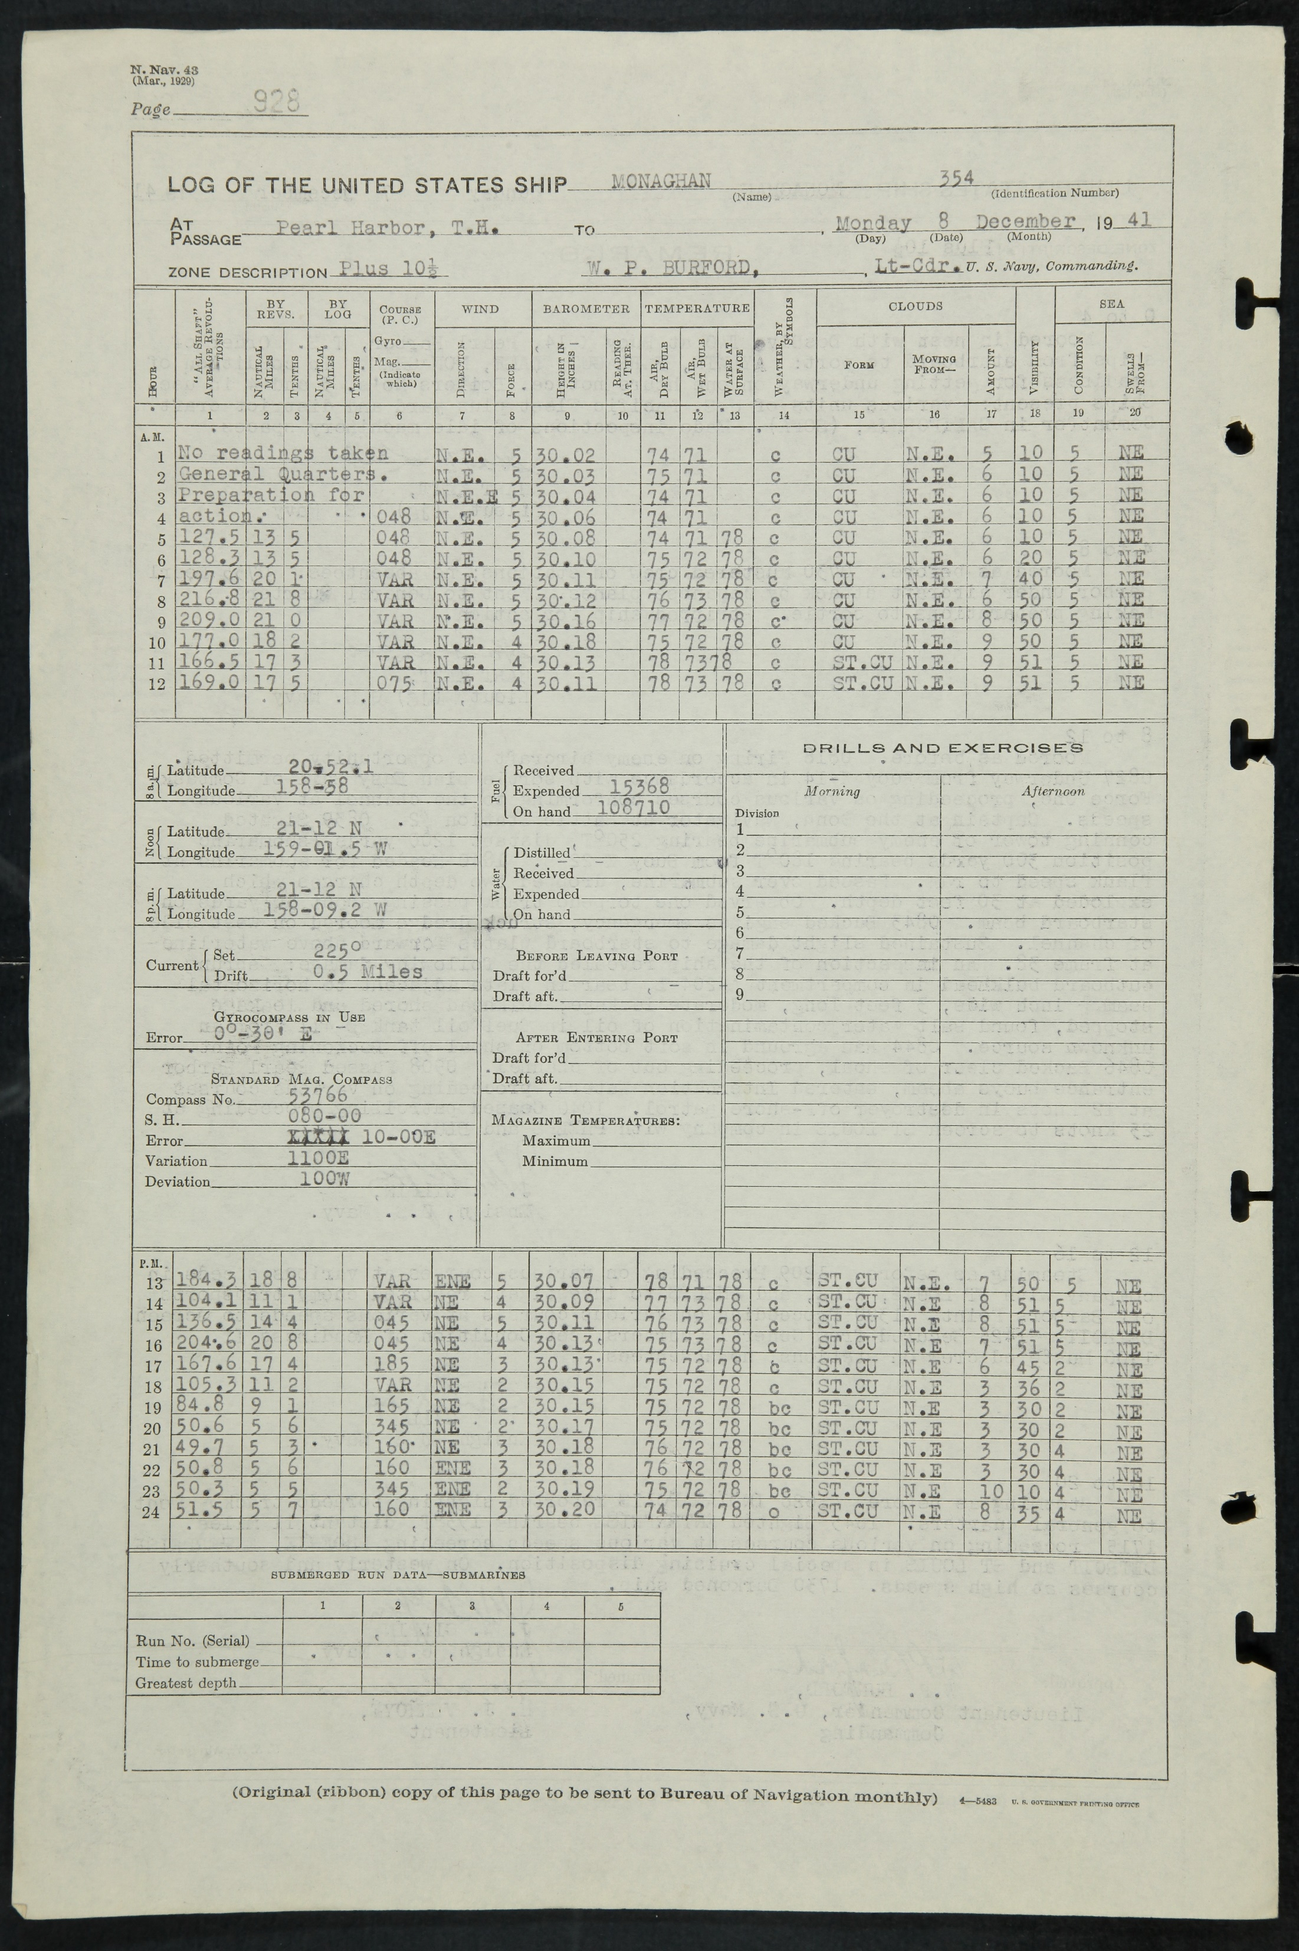
1.3 Million pages of US Navy log images
Fairly consistent format, mostly typescript
WW2 and after – covers the 1941 and 1946 data transitions
100,000,000 observations if fully transcribed
(99% new to ICOADS)
500,000 pages of images from UK archives
Very diverse formats, mostly manuscript.
Mostly C19 and early C20 – much from data poor areas
like the Southern Ocean
~ 10,000,000 observations if fully transcribed
(~90% new to ICOADS)
All data on MASS (a few Tb of data)

Slide 2
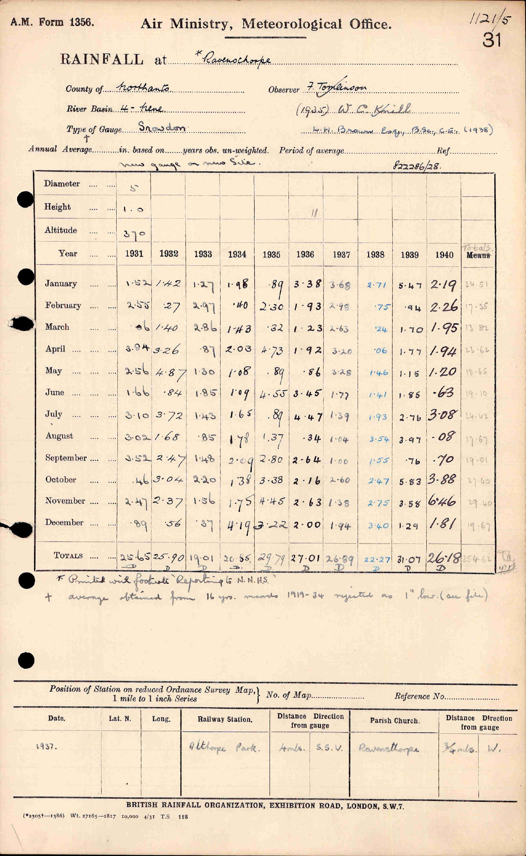
1931,1932,1933,1934,1935,1936,1937,1938,1929,1940
1.52,1.42,1.27,1.98, .89,3.38,3.68,2.71,5.47,2.19
2.55, .27,2.97, .40,2.30,1.93,2.98, .75, .94,2.26
.06,1.40,2.86,1.43, .32,1.23,2.63, .24,1.70,1.95
3.94,3.26, .87,2.03,4.73,1.92,3.20, .06,1.77,1.94
2.56,4.87,1.30,1.08, .89, .86,3.28,1.46,1.15,1.20
1.66, .84,1.85,1.09,4.55,3.43,1.77,1.41,1.86, .63
3.10,3.72,1.43,1.65, .89,4.47,1.39,1.93,2.76,3.08
3.02,1.68, .85,1.78,1.37, .34,1.04,3.54,3.97, .08
3.52,2.47,1.48,2.09,2.80,2.64,1.00,1.55, .76, .70
.46,3.04,2.20,1.38,3.38,2.16,2.60,2.47,5.83,3.88
2.47,2.37,1.56,1.75,4.45,2.63,1.38,2.75,2.58,6.46
.89, .56, .57,4.19,3.22,2.00,1.94,3.40,1.29,1.81

Slide 3
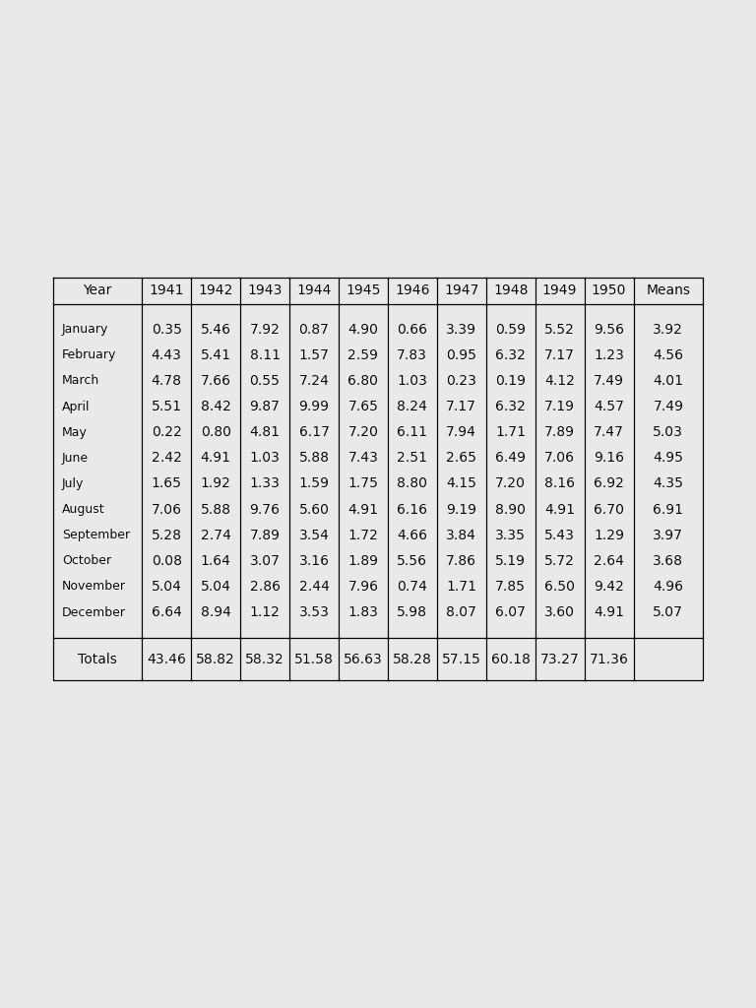

Slide 4
Convolution
Convolution
Convolution
Convolution
Images
Convolution
[[ 0.0,0.0,0.9,0.1, …],
[ 0.2,0.2,0.3,0.0, …],
…
[1.0,0.0,0.0,0.0,…]]
L1 regularisation
Dense
Softmax
Digit probabilities

Slide 5
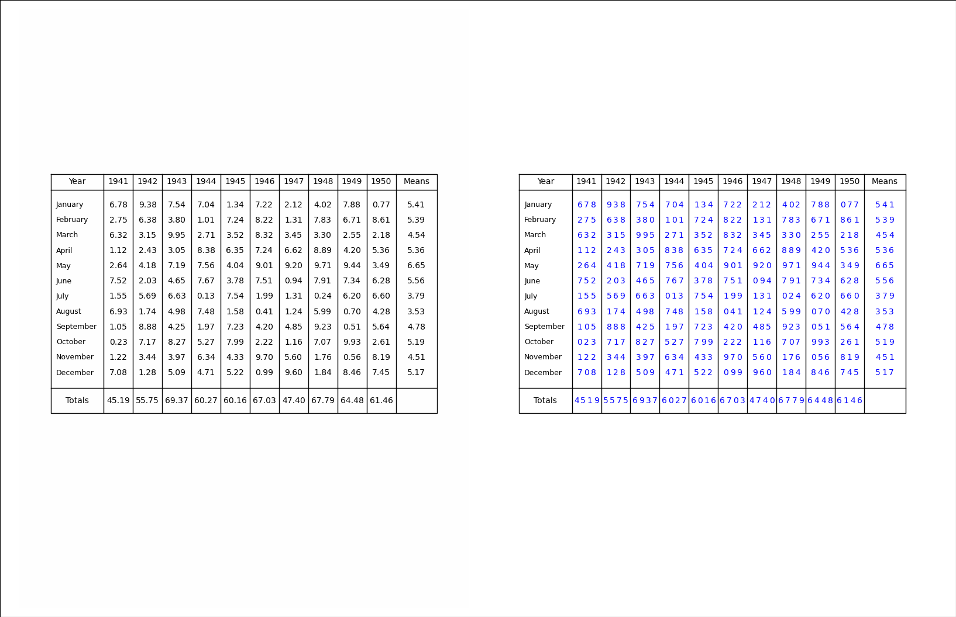

Slide 6
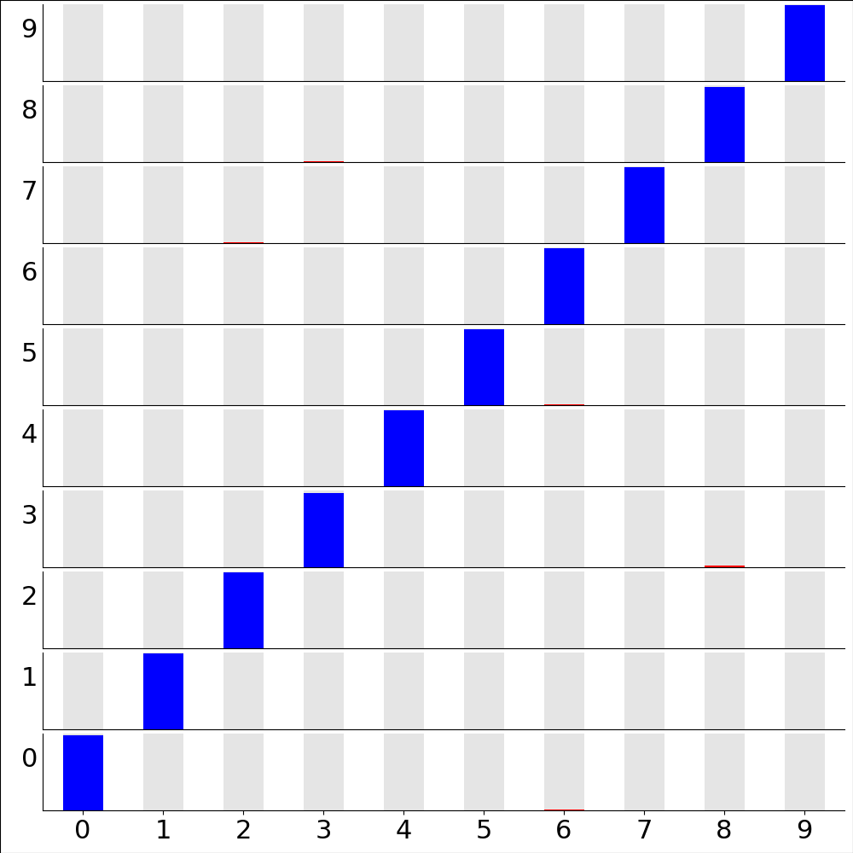

Slide 8
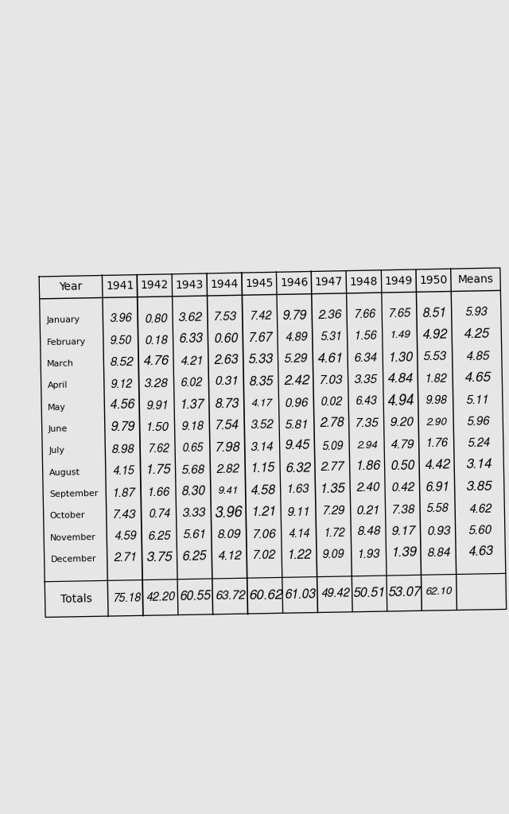
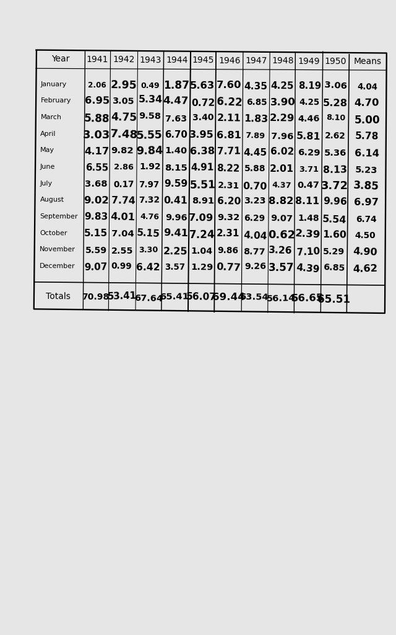
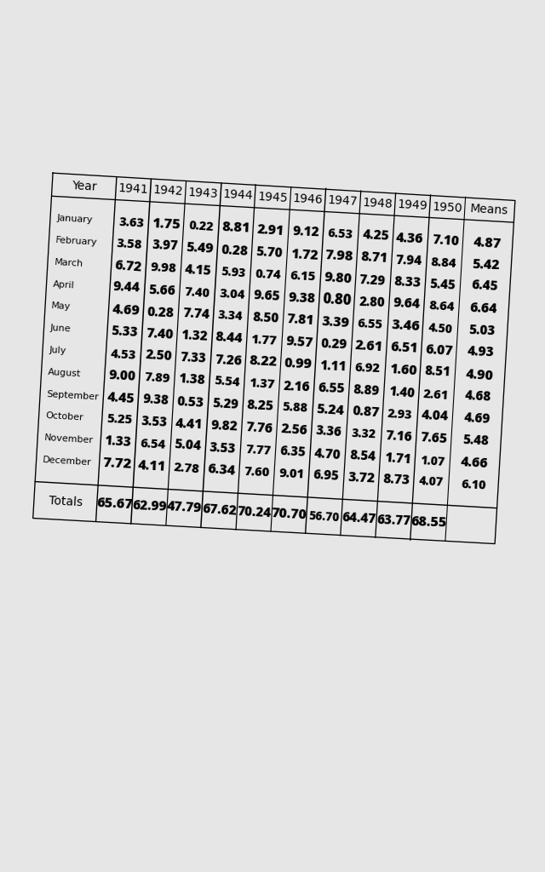
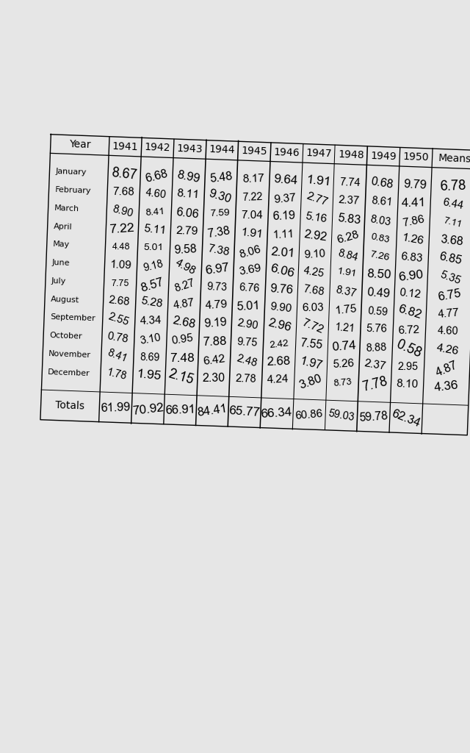

Slide 9
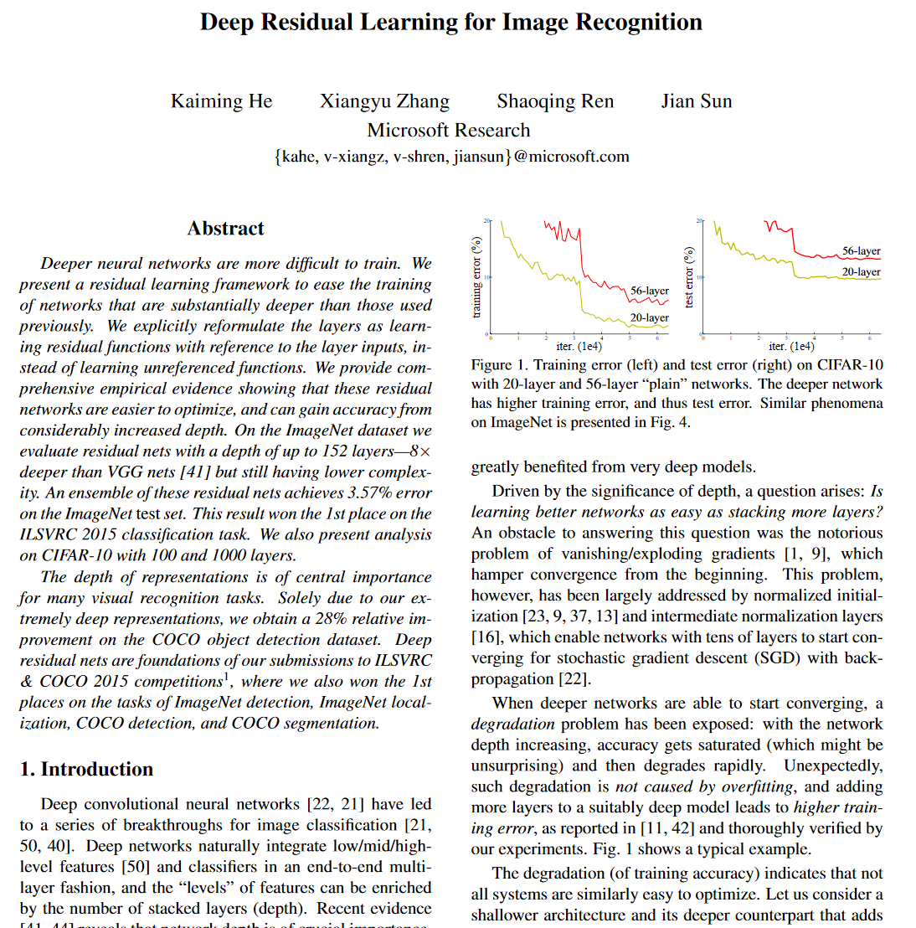
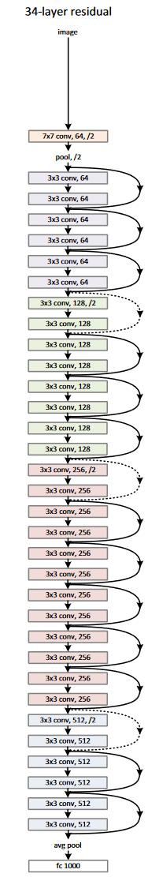

Slide 10
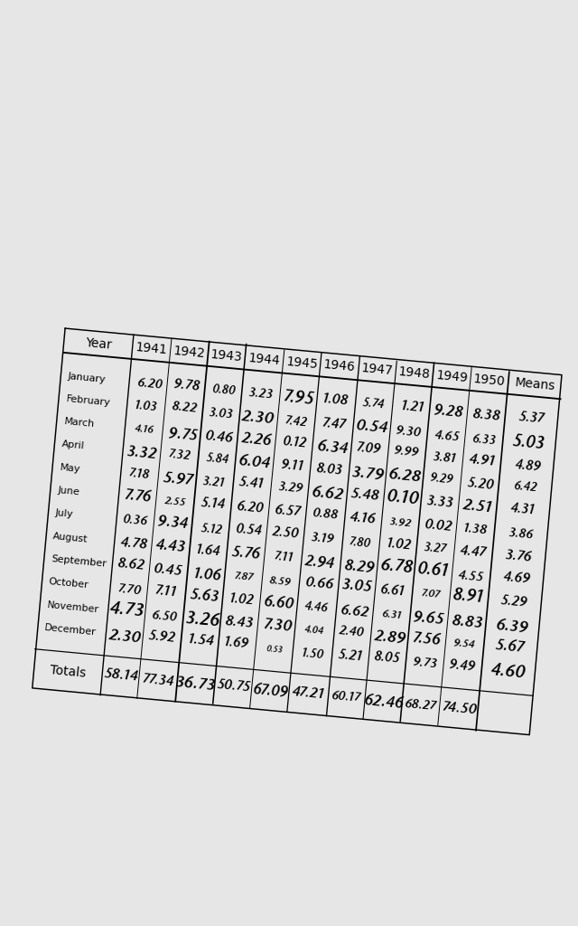
ResNet n
Images
[[ 0.0,0.0,0.9,0.1, …],
[ 0.2,0.2,0.3,0.0, …],
…
[1.0,0.0,0.0,0.0,…]]
Global Average Pooling
Softmax
Digit probabilities

Slide 11


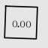
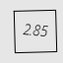
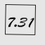
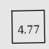

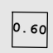
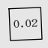
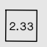

Slide 12
ResNet n
Images
Global Average Pooling
[[ 0.0,0.0,0.9,0.1, …],
[ 0.2,0.2,0.3,0.0, …],
[ 1.0,0.0,0.0,0.0, …]]
Softmax
Digit probabilities

Slide 13
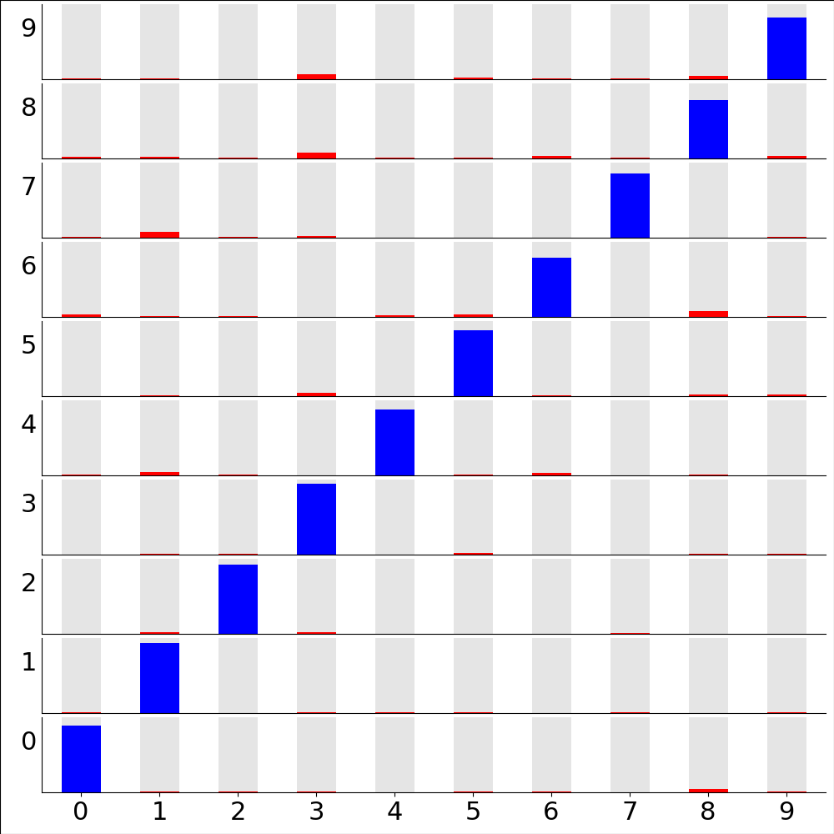

Slide 14
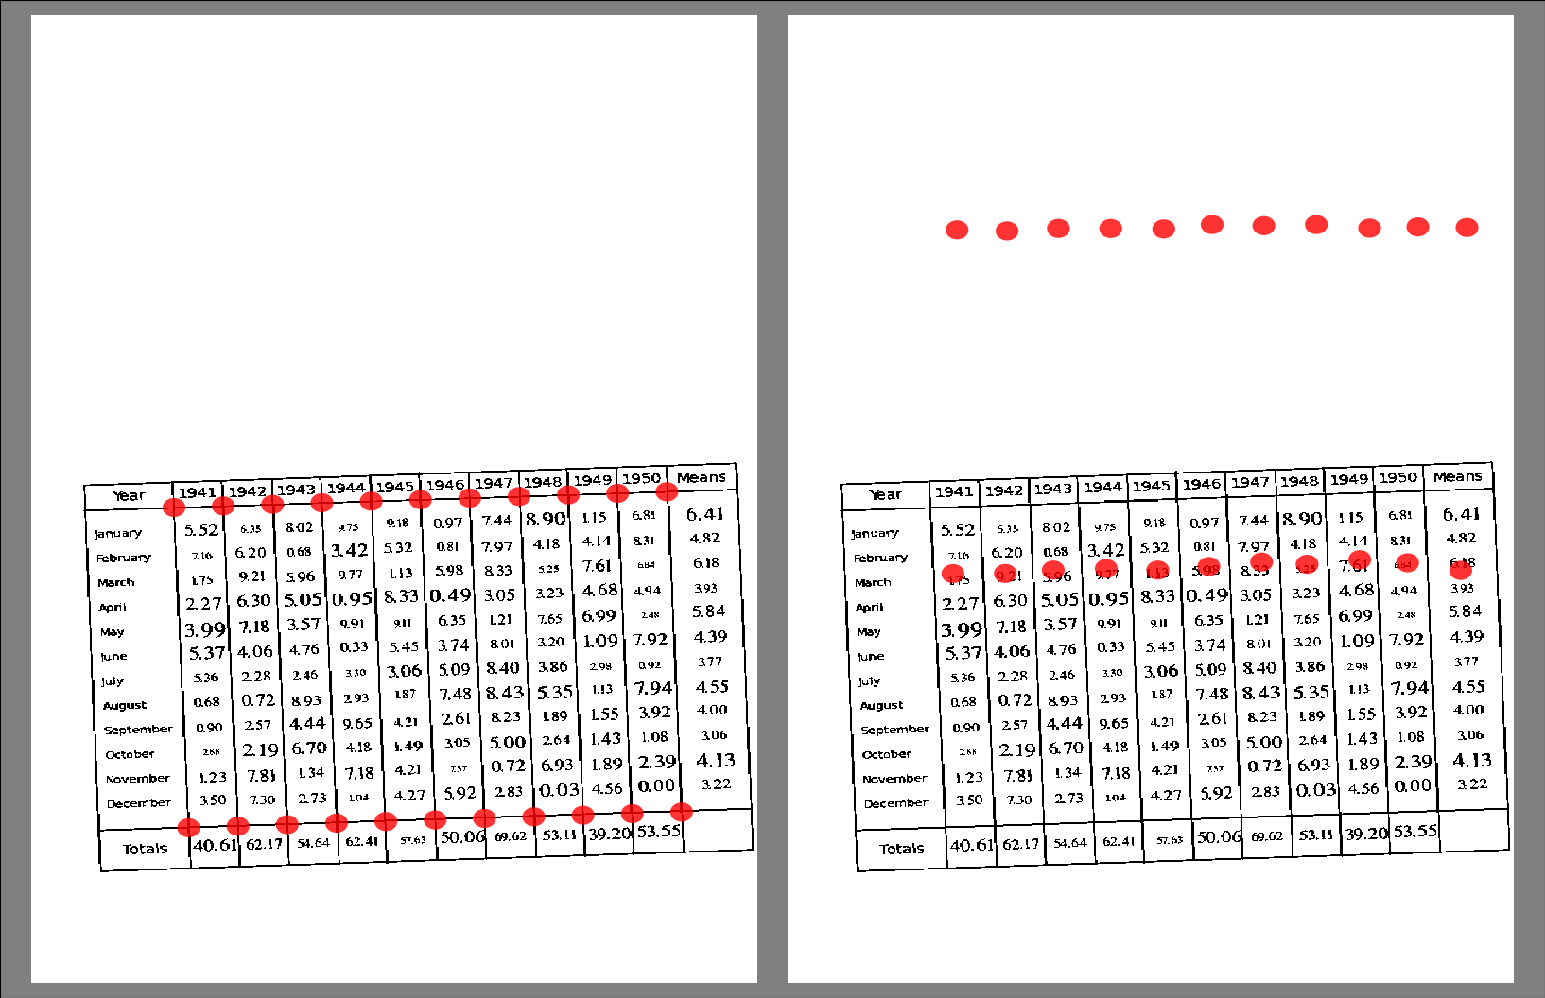

Slide 15
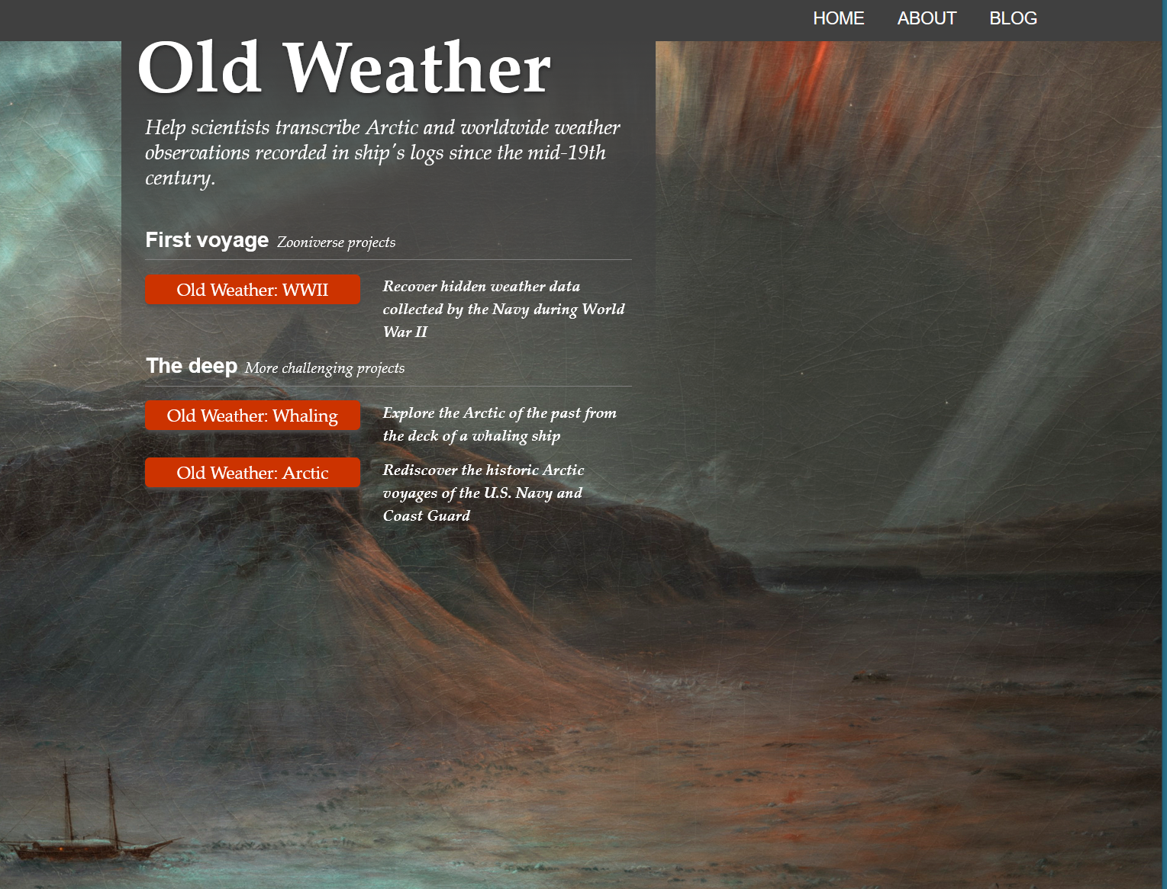
http://oldweather.org

Slide 16
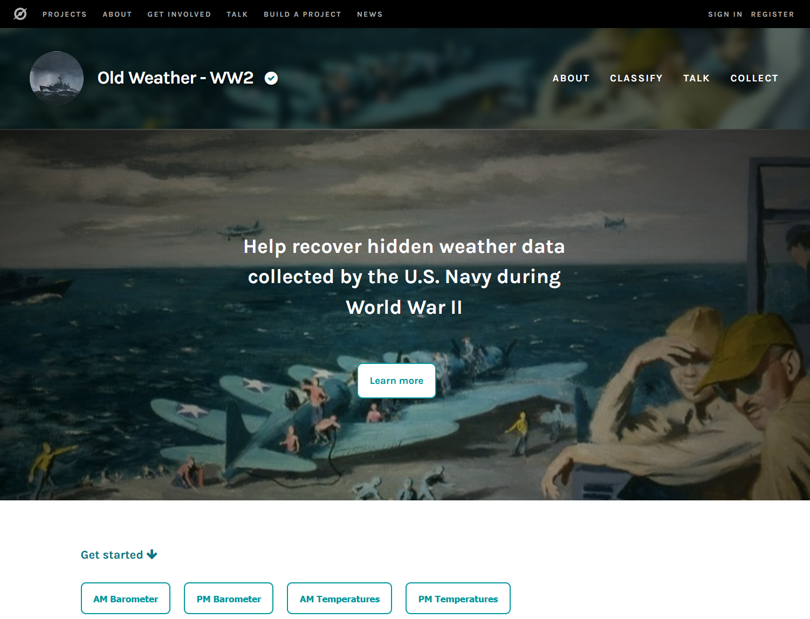
https://www.zooniverse.org/projects/krwood/old-weather-ww2

Slide 17
If you want more historical weather observations,
we’ve got them – lots of them *
State of the art transcription process is still citizen science
see oldWeather WW2 for best practice
Machine learning methods can do text transcription well
Image analysis is still a challenge
TensorFlow is awesome
Watch this space
Coronavirus sucks
* Some work required on transcription and QC

